Slide 1

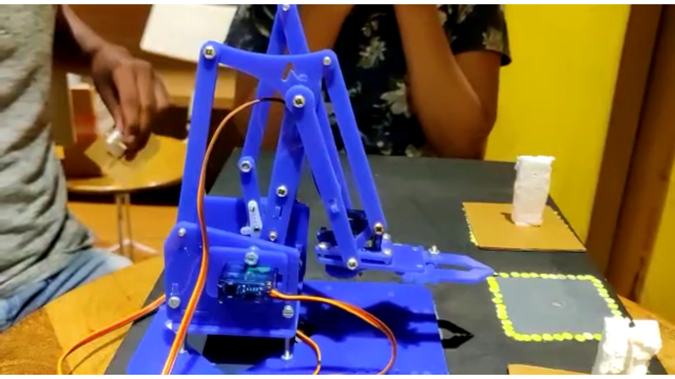
AUTOMATED ROBOTIC ARM

Slide 2
CODE FIEND
Neeyati Mehta : FCAIT (BCA), GLS University mehtaneeyati@gmail.com
Harshita Balani : FCAIT (BCA), GLS University
Harsh Shah : FCAIT (BCA), GLS University
Nisarg Jhatakia : FCAIT (BCA), GLS University

Slide 3
Problem Definition
Today, technology is developing in the same direction in line with rapidly increasing human needs. The work done to meet these needs makes life easier every day. Robot arms work with an outside user or by performing predetermined commands.
One of the main problem that we face today is that we are still majorly dependent on the laborers or daily workers to do the heavy lifting manually. This always puts them at a high risk of injury. With our project, we can automate this tedious task.
In this project, we will have many predetermined drop positions and a specific pick-up location. The arm will pick the object available at the pickup spot and place it at any of the available aforementioned drop location.

Slide 4
Components
Arduino Uno
Acrylic Sticks and boards
Servo Motor
Light Dependent Resistors (LDR)
Bread Board
Jumper Wires
Bolts and screws
10k resistor

Slide 5
Working
Trying to automate the transportation system practiced in industrial warehouses.
Drop spots and the pickup location have an LDR attached to them for detecting the presence of an object.
If the arm detects an object on the pick-up location, it checks the availability at all the drop location.
If none of the drop locations are free, the arm wouldn’t move. Else, it will pick up the object from the pick up spot and drop it on any of the available drop locations.

Slide 6
Application
This arm can be used in any of the industrial warehouses where internal transportation of goods takes place

Slide 7

Advantages
1
2
3
Cost Effective
Optimized and
Efficient
Reduces the risk
of workplace
injuries

Slide 8
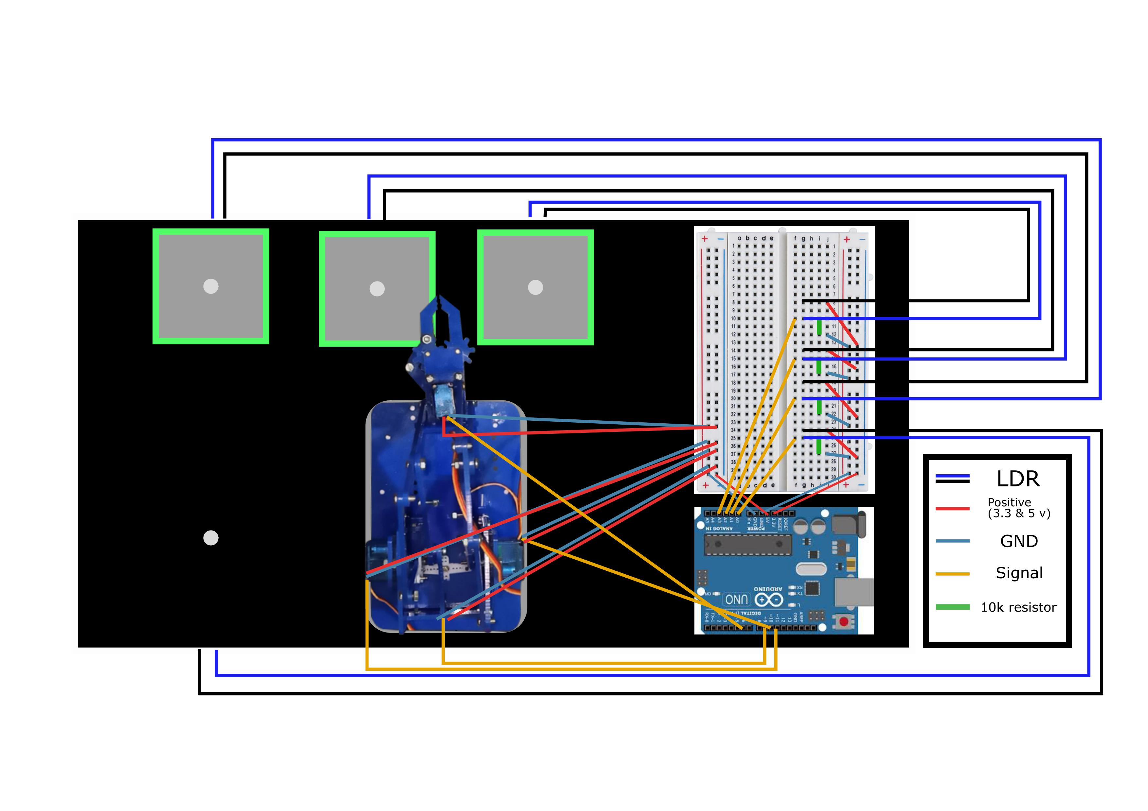
Circuit Diagram

Slide 9

Future Expansion?

Slide 10

This project was made by :-
Neeyati Mehta Harshita Balani
Harsh Shah Nisarg Jhatakia

